Slide 1
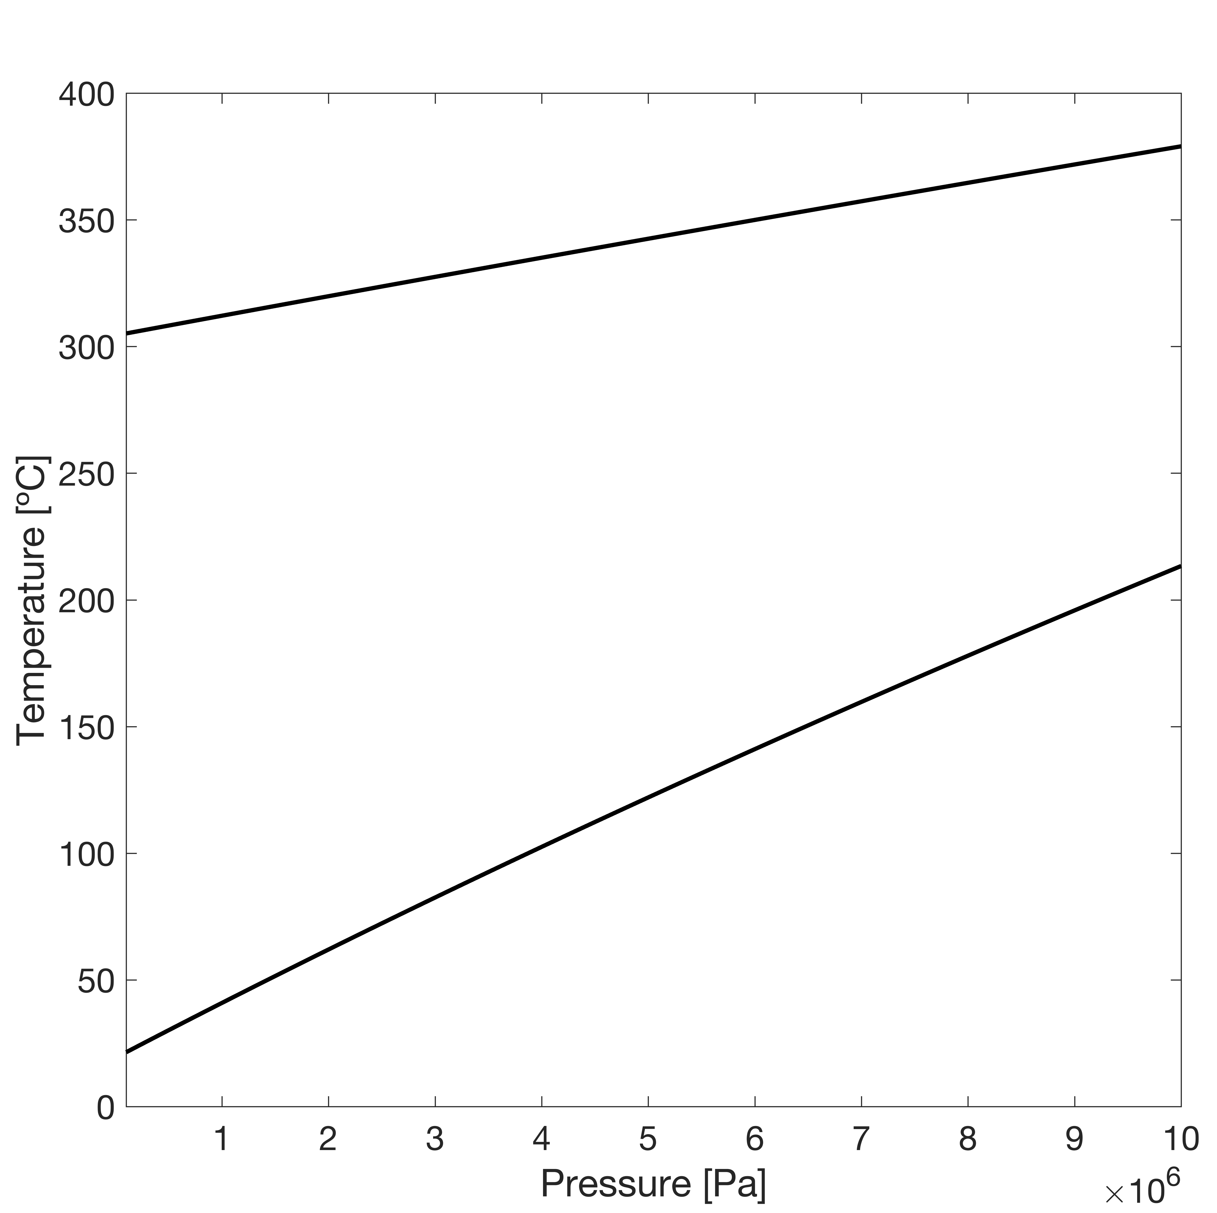



$$2Al+2H_{2}O→3H_{2}+Al_{2}O_{3}$$
$$2Al+4H_{2}O→3H_{2}+2AlO\left(OH\right)$$
$$2Al+6H_{2}O→3H_{2}+2Al{\left(OH\right)}_{3}$$

Slide 2
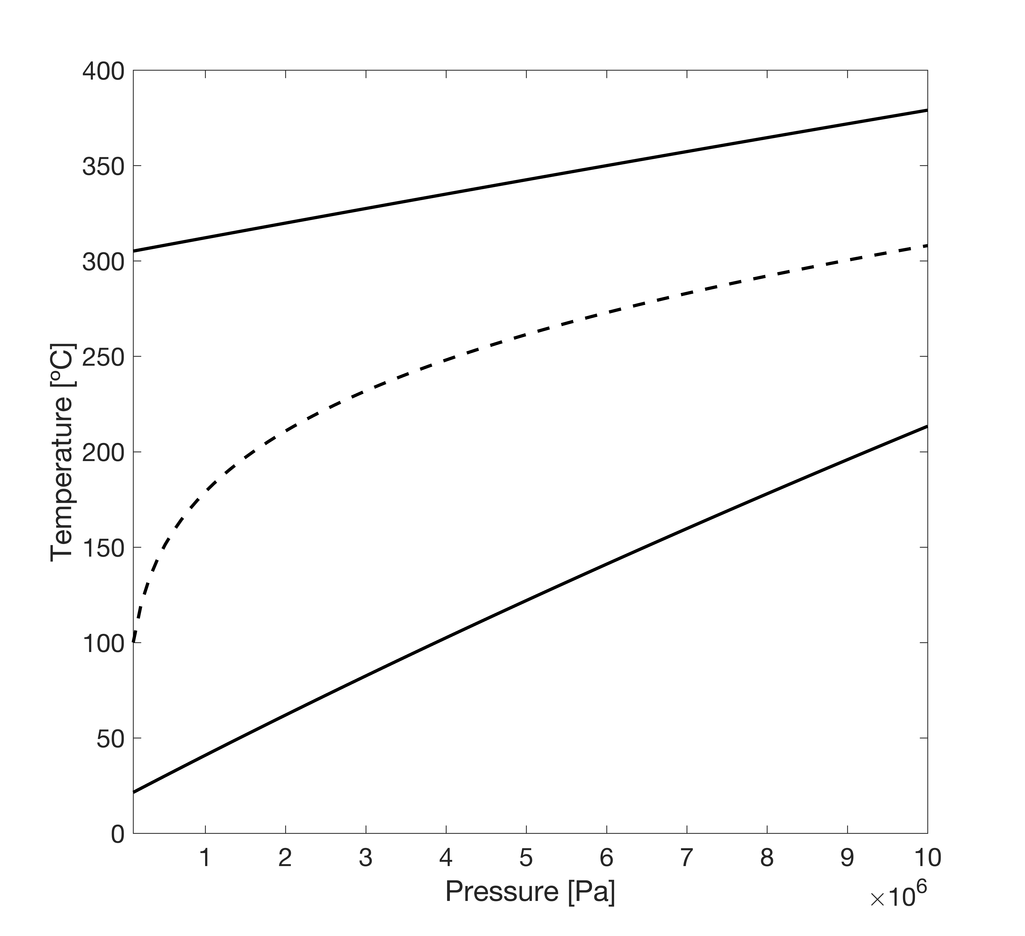

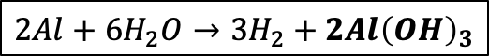


$$2Al+2H_{2}O→3H_{2}+Al_{2}O_{3}$$
$$T_{sat}$$
$$2Al+4H_{2}O→3H_{2}+2AlO\left(OH\right)$$
$$2Al+6H_{2}O→3H_{2}+2Al{\left(OH\right)}_{3}$$

Slide 3
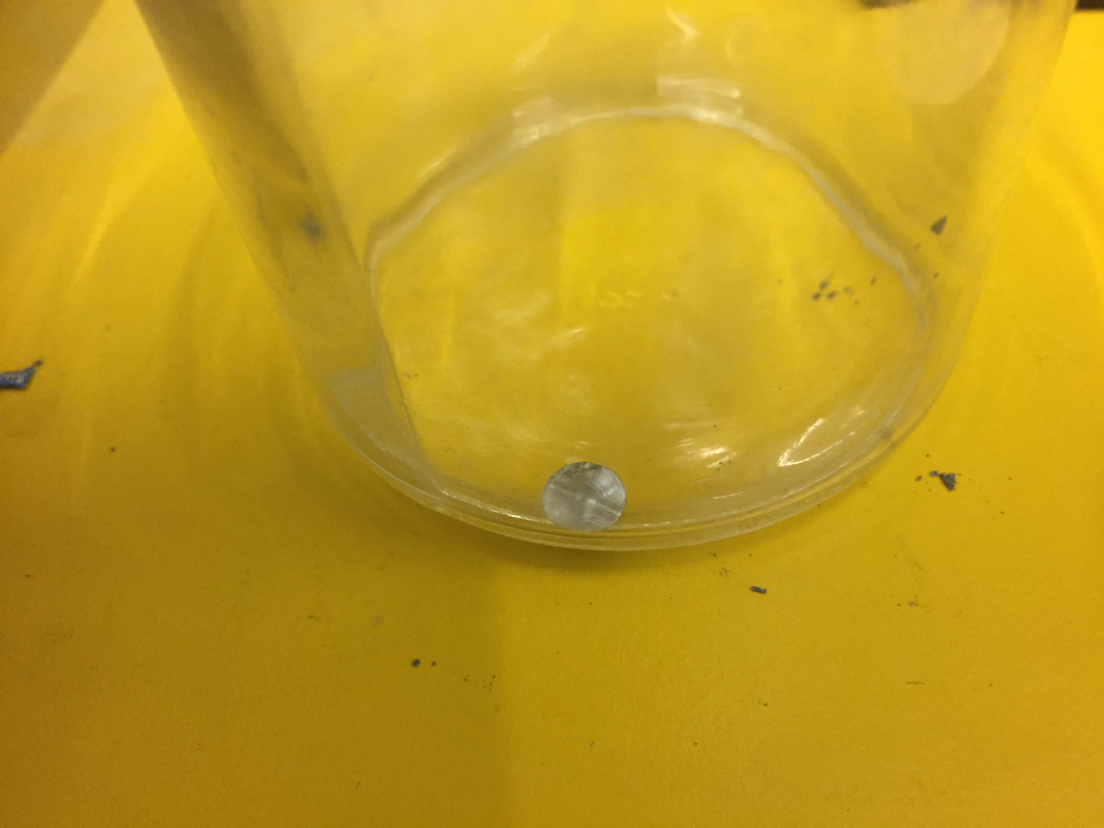
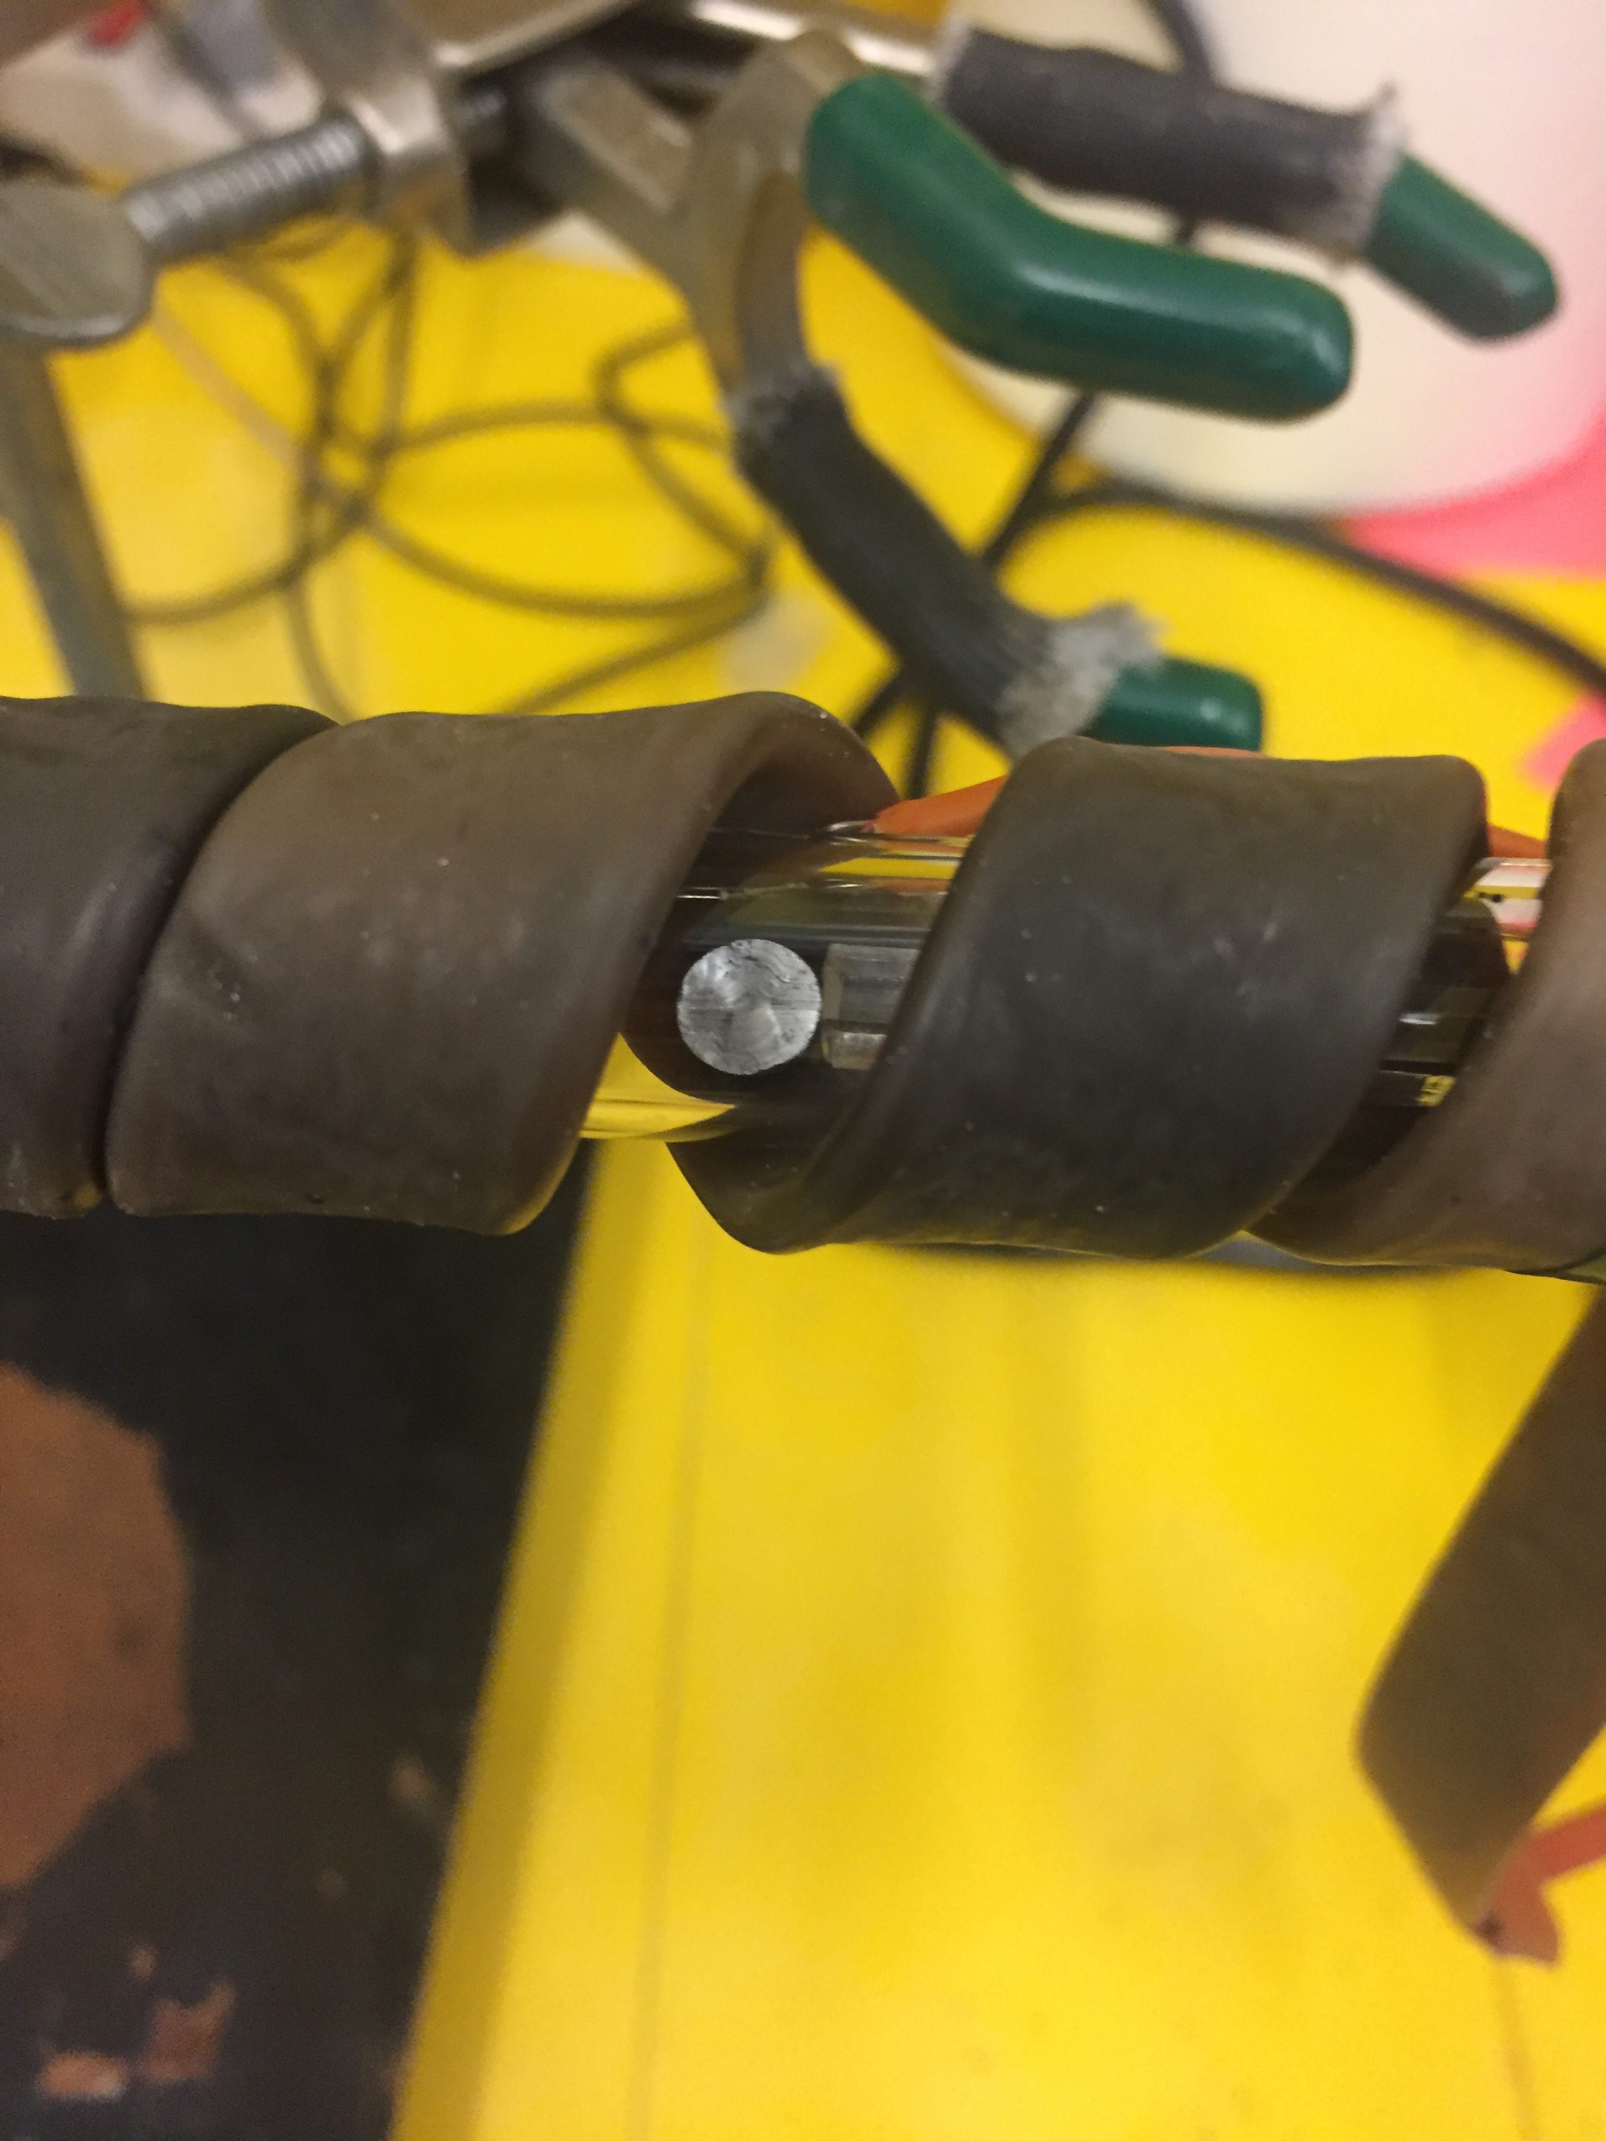
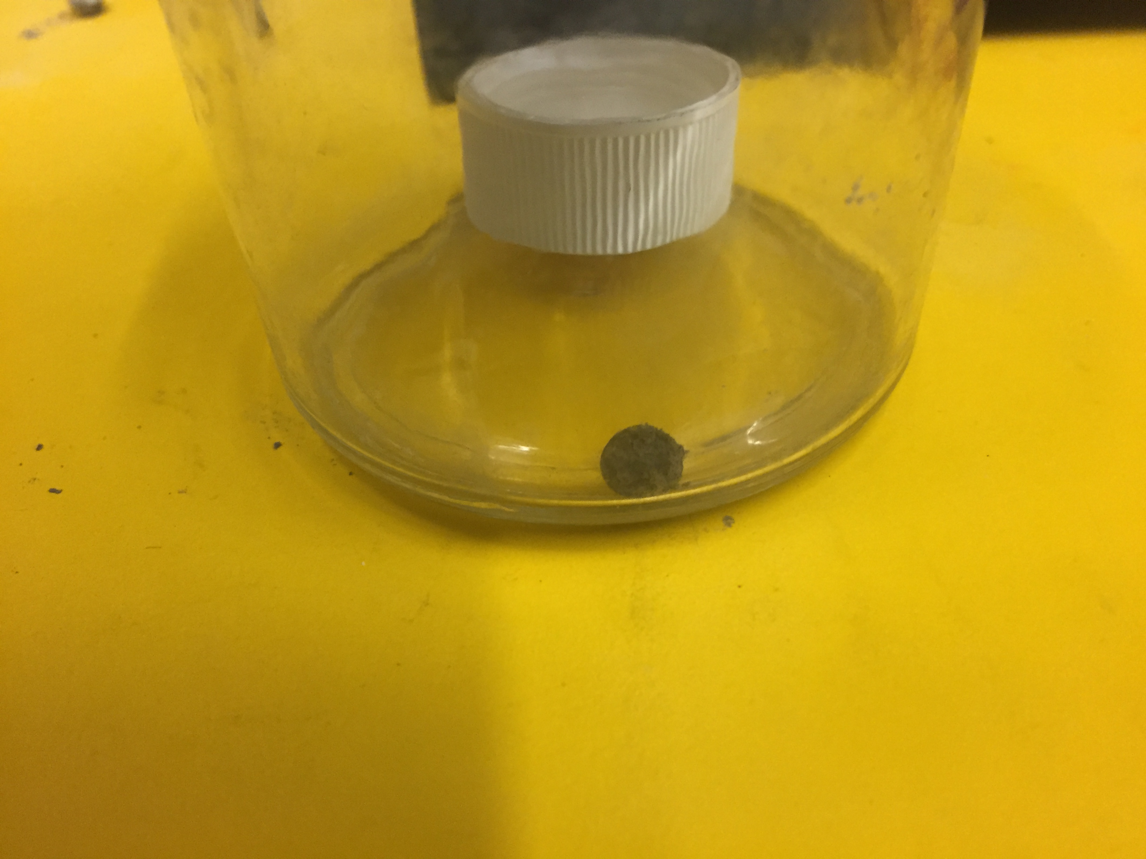
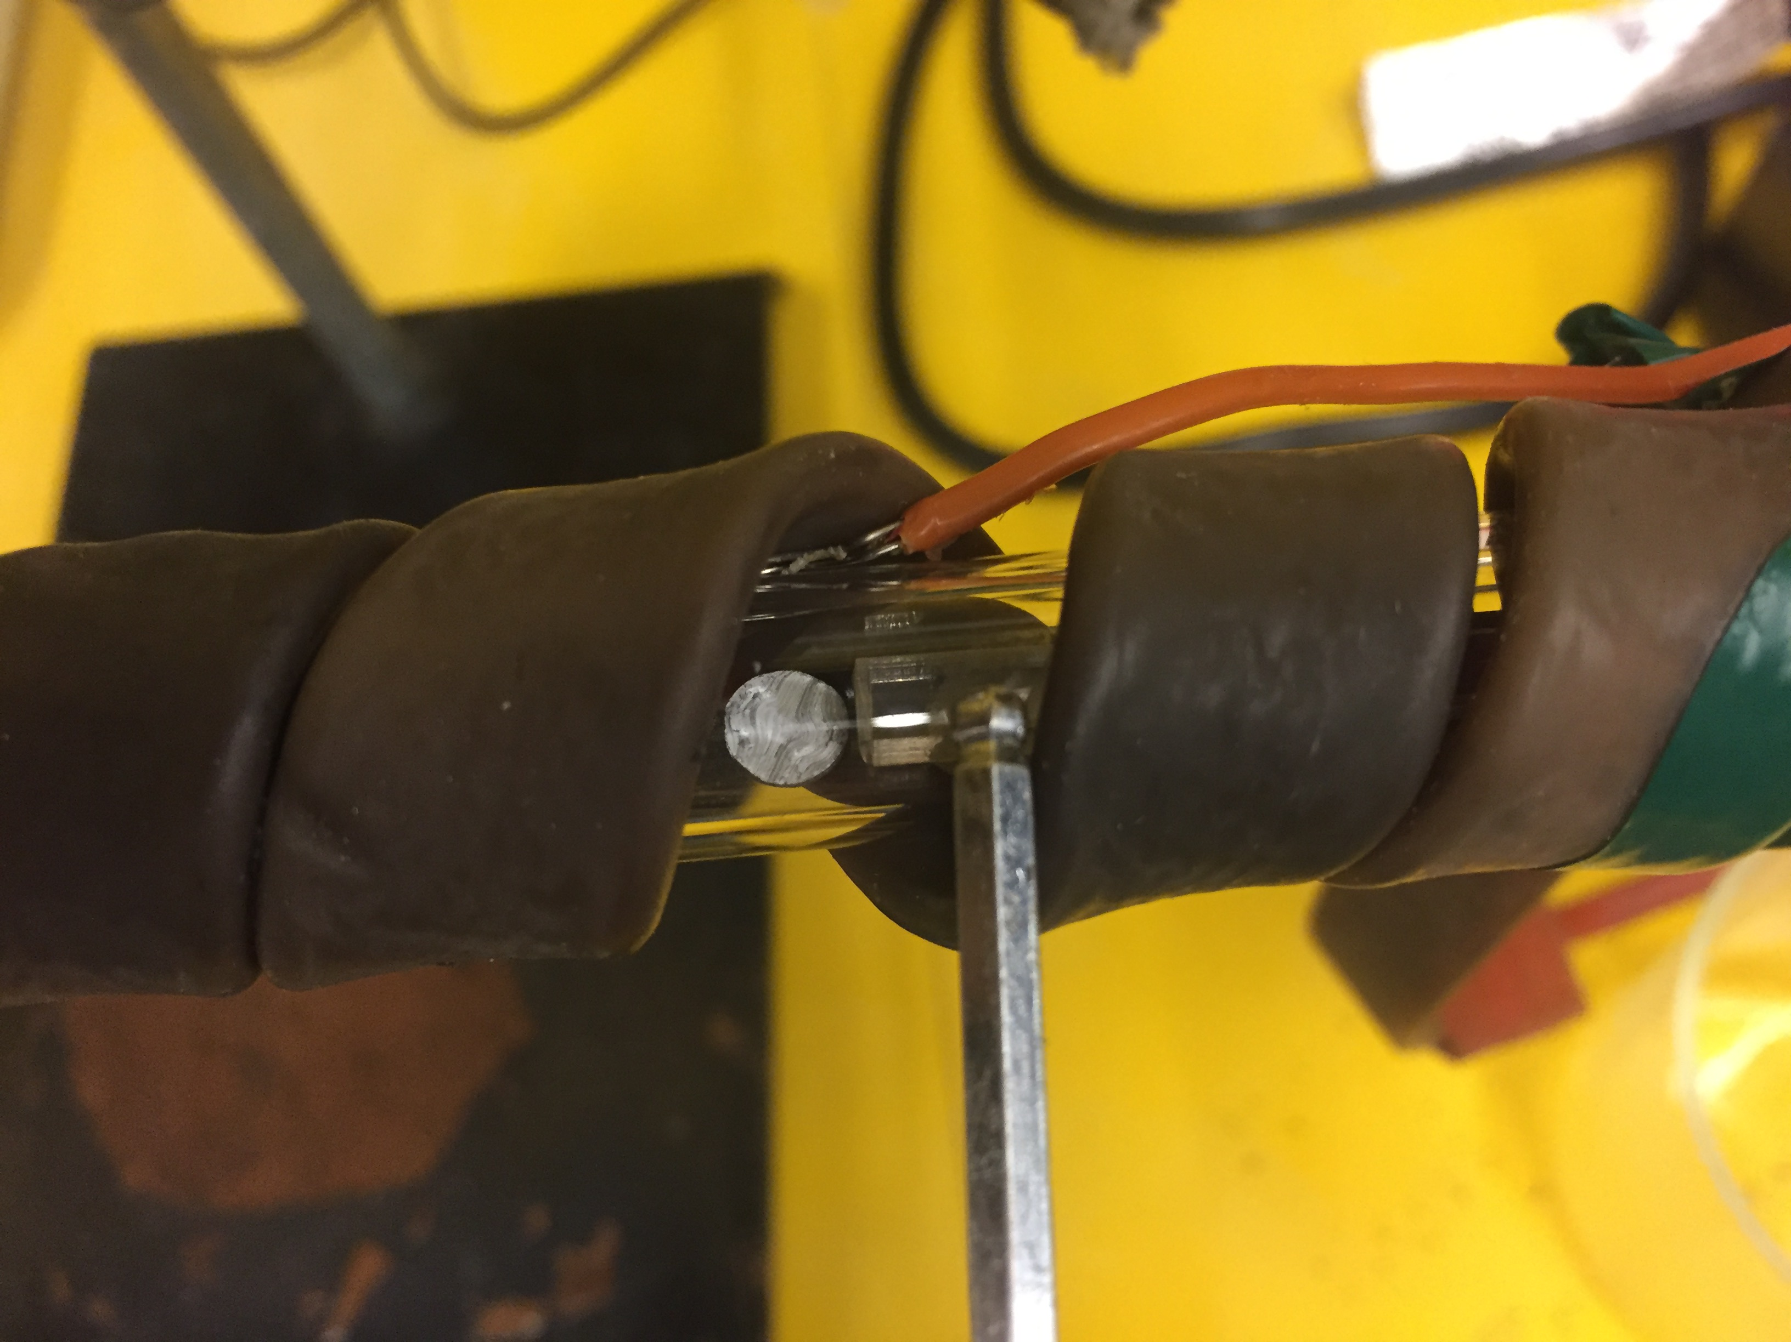
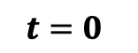
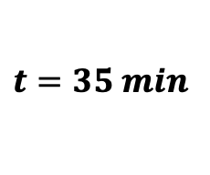
100% RH Air @ 20 ºC
Steam @ 150 ºC
a)
b)
$$t=0$$
c)
d)
$$t=35 min$$

Slide 4
a)
b)
c)
d)

Slide 5
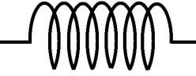
Resistive Heater
Hydrogen
Bubble
Activated Aluminum
Water
Steam
Water
+
-
Hot Plate
Heater
Controller

